Slide 1

Project 1

Slide 2
TEAM MEMBERS
Yiling Chen
Laura Sunley
Logan Chancellor-Gonzales
Susan Lin
Xian Sheng
Notes:
My name is Yiling Chen. Let me introduce my team member. They are Laura, Logan, Susan, and Xian

Slide 3

HEART FAILURE
Age
Anemia
Creatinine Phosphokinase
Diabetes
Ejection Fraction
High Blood Pressure
Platelets
Serum Creatinine
Serum Sodium
Sex
Smoking
Time
Death Event
Notes:
Today we talk about Heart failure and our data is come from Kraggle and have 300 database. heart failure seems to be a serious and life-threatening condition that significantly impacts a large portion of the global population. Our analysis seeks to shed light on heart failure by examining factors such as age, gender, and physical data. The goal is to develop a clearer understanding of which demographics are more susceptible to heart failure and to identify effective prevention strategies.

Slide 4
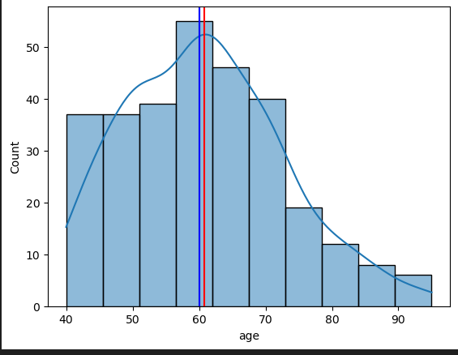
HOW DOES AGE RELATE TO CARDIAC FAILURE
Heart changes with age.
Heart failure becomes more common as we are getting older.
Based on the dataset, the average age of heart failure is 60 with a minimum of 40 and maximum of 95.
The highest death rate occurs between 50 and 70.

Slide 5
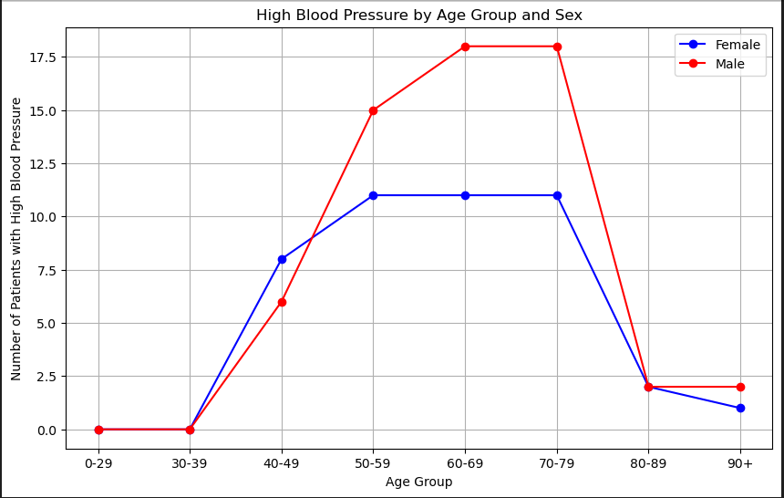
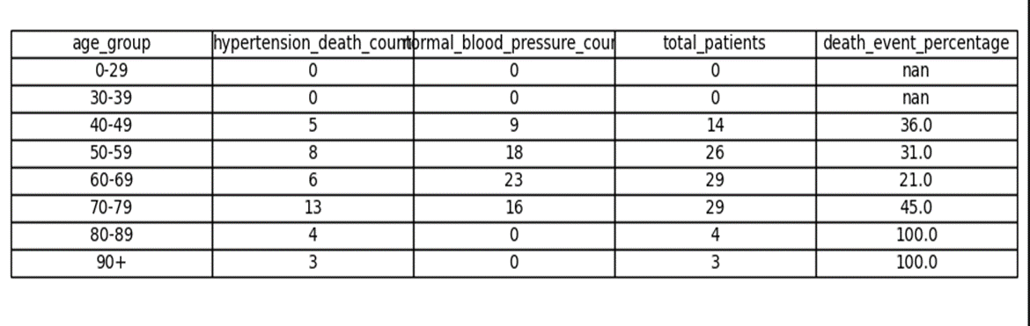
HOW THE PHYSICAL DATA TO AFFECT CARDIAC FAILURE
High Blood Pressure
High blood pressure (BP), is major modifiable risk factors for heart failure.
Persistent high blood pressure can damage blood vessels and increase the likelihood of a heart attack.
High blood pressure increases with age (high rate in 60 to 70)
The age around 40 to 49, death event is 36%, 50 to 59, death event - 31%, 60 to 69 : death event is 21%, 70-79 : death event is 45%, 80 and above is 100%.
The people in high blood pressure have different odds of developing heart failure.
Male generally having a higher risk than female.
Next: Laura!

Slide 6
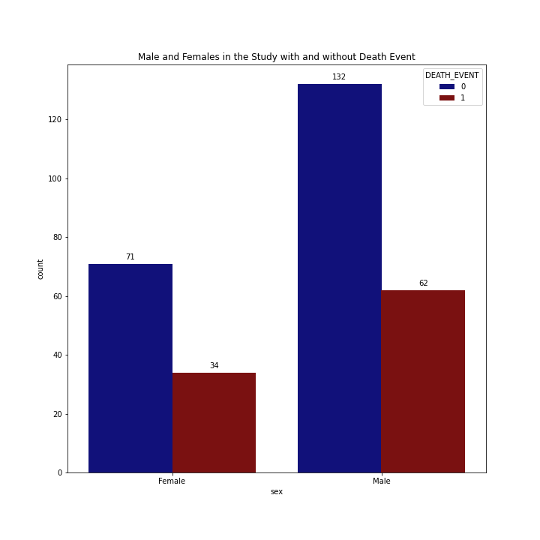
Question: Does biological sex play a factor in heart failure?
Out of the 299 patients in this study, with 105 females and 194 males.
Of the 96 patients who died, 64.58% were male, and 35.42% were female.
Males had a significantly higher death rate compared to females.

Slide 7
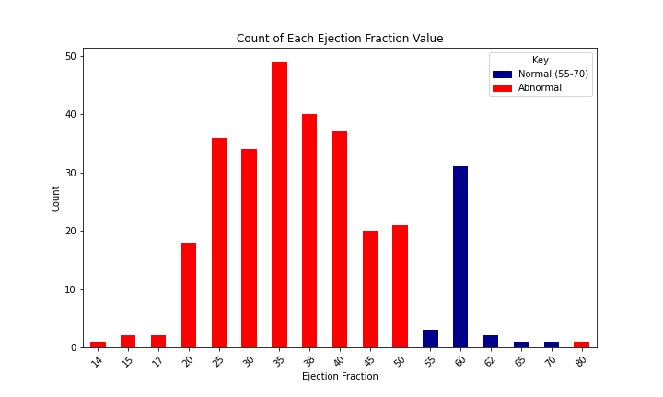
Ejection Fraction
Ejection fraction (EF) is a measurement used to assess how well your heart is pumping blood.
Normal Range: A normal ejection fraction typically ranges from 55% to 70%.
The majority of these patients have ejection fractions of less than the normal range.

Slide 8
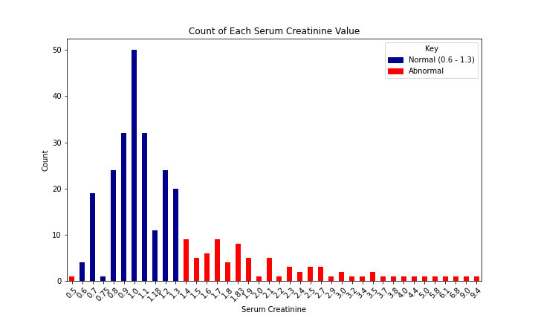
Serum Creatinine
Normal levels for men and women is about 0.6 to 1.3 mg/dL.
A high serum creatinine level typically indicates that the kidneys are not functioning properly.
The amount of patients that fell in the normal range was greater than those outside of it.
82 abnormal
217 normal

Slide 9
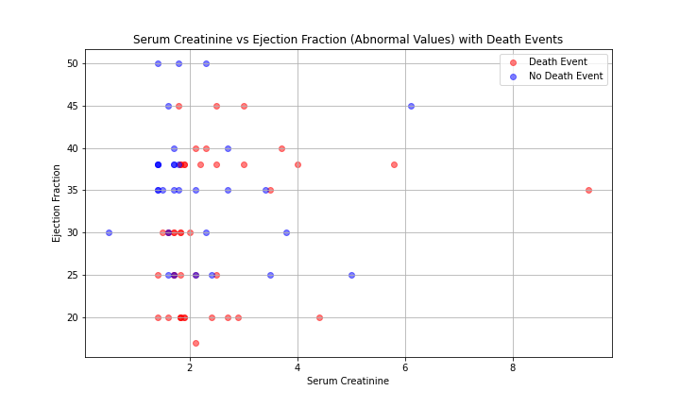
Question: Are there clear signs from the combination of these factors that heart failure may occur?
Based on the data alone, it doesn't seem easy to visually identify a pattern, as both deaths and non-deaths occur within the same clusters.
There were a significant amount of deaths among patients with an ejection fraction of 20 and serum creatinine close to 2.
Normal ejection = 55 to 70
Normal serum = 0.6 to 1.3
Next: Logan!

Slide 10
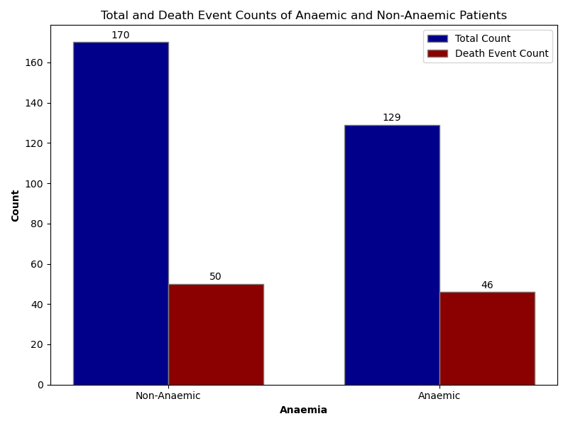
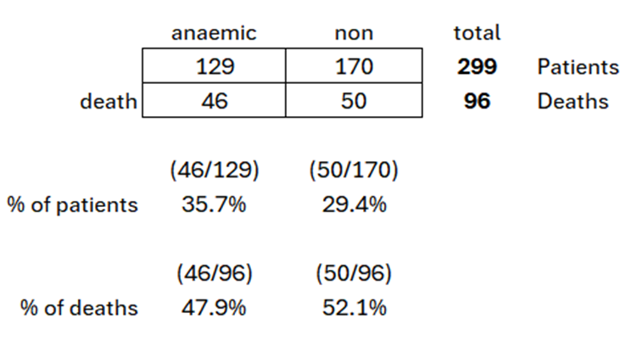
Anaemic Patients vs Non-Anaemic Patients
The study of 299 patients (129 anaemic, 170 non-anaemic) found 96 deaths: 46 anaemic (35.7%), making up 47.9% of total deaths and 50 non-anaemic (29.4%), making up 52.1% of total deaths.
Although anaemic patients had a higher death rate, most deaths were in the non-anaemic group, suggesting anaemia may not significantly impact heart failure.

Slide 11
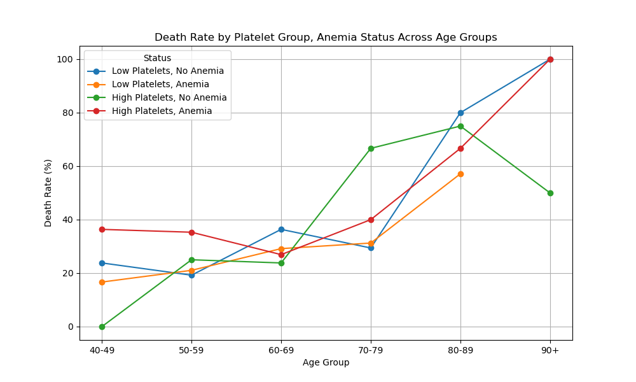
Anaemic status vs Age and Platelet Levels
How do age, platelets and anemia correlate to Heart failure?
Low Platelets: Non-anemic patients (blue) have lower death rates until age 80, while anemic patients (orange) show low but steadily increasing rates with age.
High Platelets: Non-anemic death rates (green) rise after 50, peaking at 80-89, while anemic patients (red) face high mortality, sharply increasing after 60.
In conclusion, both patients with low platelets without anemia and patients with high platelets with anemia pose risks, but the patients with high platelets with anemia generally lead to higher mortality rates within each age group before the oldest age bracket where both groups align at similar death rates.
Next: Susan

Slide 12
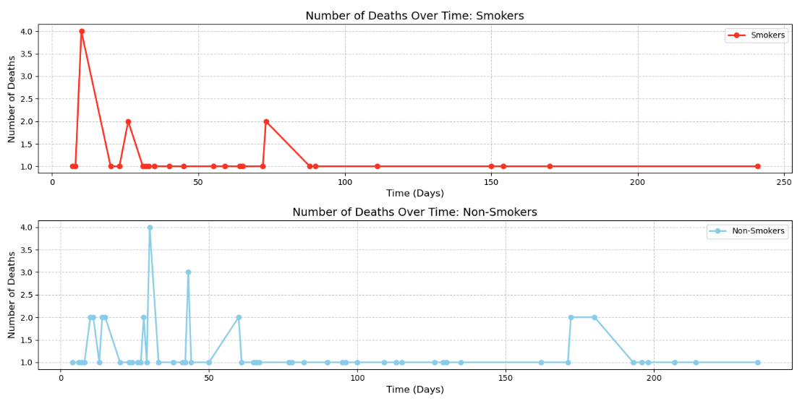
Number of Deaths Over Time: Smokers vs Non-Smoker
Smokers (Red Line): Larger spikes in deaths early in the timeline, indicating a higher death rate among smokers early on.
Non-Smokers (Blue Line): This indicates that non-smokers generally have a lower and more consistent mortality rate over time.

Slide 13
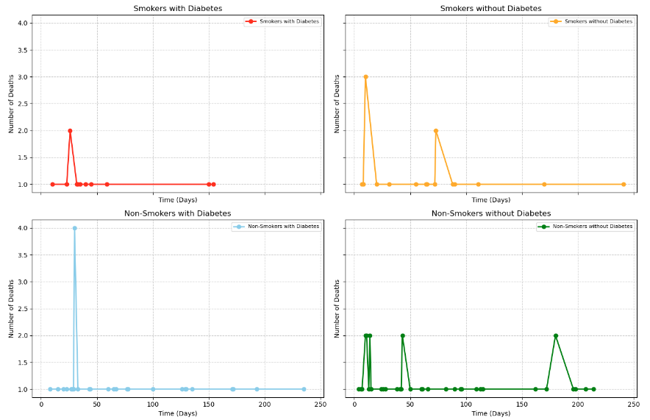
Number of Deaths Over Time: Smoking and Diabetes Correlation
Smokers with Diabetes (Red Line): This group shows some initial spikes in death events, indicating a higher risk, but the death rate stabilizes quickly.
Smokers without Diabetes (Orange Line): This group shows early spikes in deaths, but the numbers decrease over time.
Non-Smokers with Diabetes (Blue Line): There is a significant drop in deaths after an initial spike, indicating that while diabetes increases the risk of death, not smoking helps mitigate this risk.
Non-Smokers without Diabetes (Green Line): This group has the lowest number of death events overall, indicating the lowest risk among the four categories
Combined Risk: The graph shows that both smoking and diabetes have huge impact with mortality and leading to the higher risk.

Slide 14
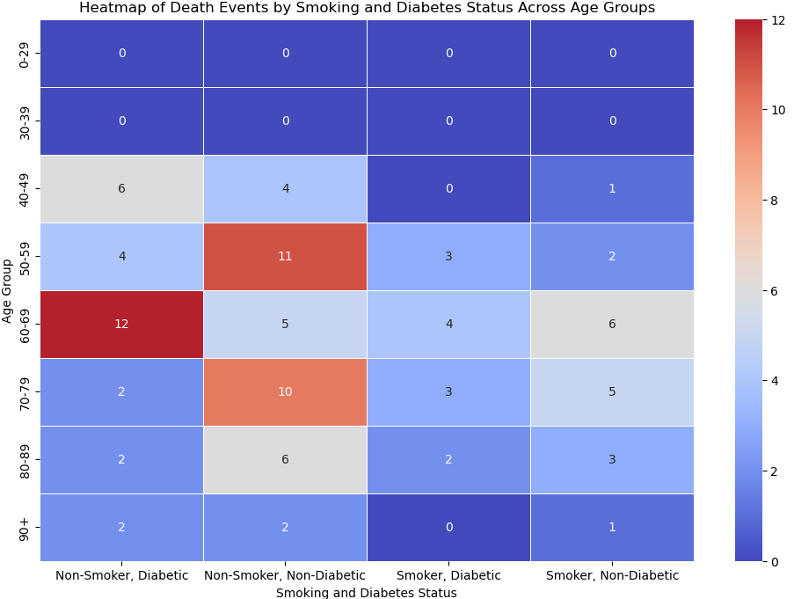
Death Events by Smoking and Diabetes Status Across Age Group
Age Group 50-59:
Highest number of death events for Non-Smoker, Diabetic.
Significant death events for Smoker, Diabetic and Smoker, Non-Diabetic.
Age Group 60-69:
High number of death events for Non-Smoker, Diabetic
Noticeable death events for Smoker, Diabetic.
Age Group 70-79:
Moderate death events across all categories, with a slight increase for Non-Smoker, Diabetic.

Slide 15
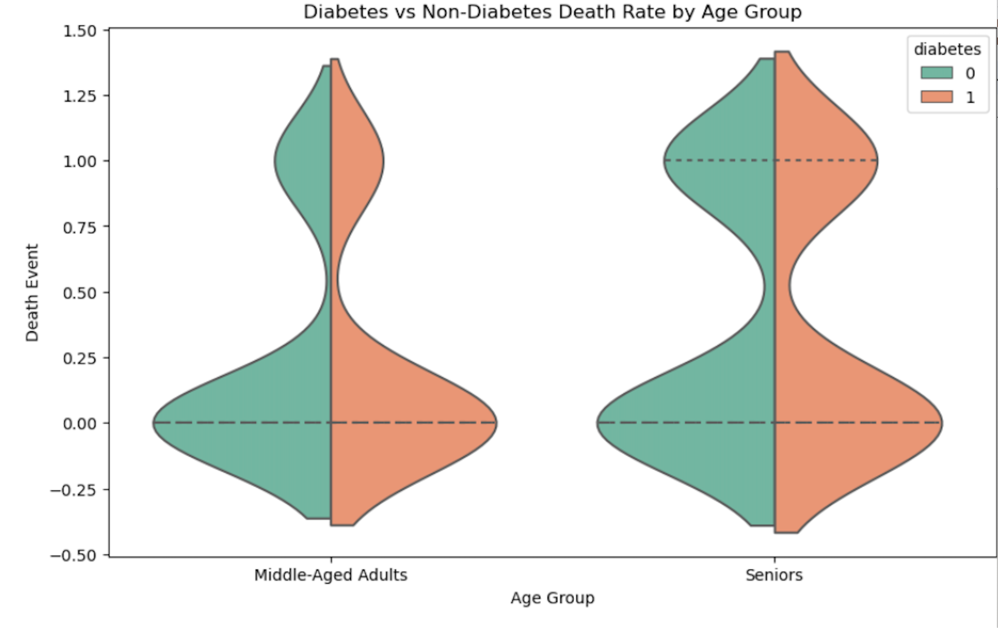
Diabetes status with Death Rate by Age Group
Diabetes is a common failure, but without timely intervention, it can significantly impact heart health, increasing the risk of cardiovascular failures.The shape of a violin plot reflects the density distribution of the data. The wider the section, the higher the frequency of data within that range. The plot on the left represents the distribution of mortality events among middle-aged adults, while the plot on the right shows the distribution of mortality events among the elderly.
In these age groups and data sets, the impact of having diabetes on mortality may not show a very significant difference, but this does not mean that diabetes has no effect on the mortality rate of heart failure patients.

Slide 16
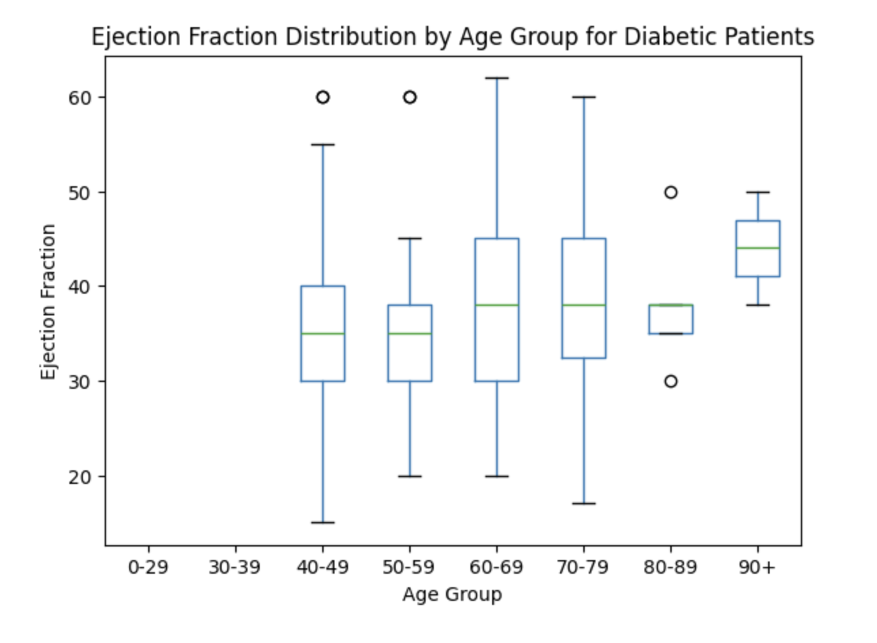
Diabetes vs. Ejection Fraction
This chart indicates that there are significant differences in ejection fraction among diabetic patients across different age groups, particularly in the 40-79 age range, where heart function tends to be more unstable.

Slide 17
Conclusion
We analyzed 299 heart failure patients and found that the average onset age is 60 years. Mortality rates increase with the number of comorbidities, highlighting the importance of managing overall health to reduce heart failure risk, alongside unchangeable factors like age and gender.

